Slide 1
IT305 Computer Networks
Week10_Lec2
Routing Information Protocol

Slide 2
Distance Vector Routing
Each node collects the knowledge of the entire network, and shares it periodically (e.g.
every 30 seconds) only with its neighbors. The knowledge is a sequence of messages:
{<source node> <dest. node> <next node> <total cost>}
Each message shows "so far optimal" route from the <source node> to the
<destination node>, where the first leg of the optimal route is <next node>, and
the total minimal cost is <total cost>.
The cost is expressed in terms of number of hops.
By getting such messages, the nodes can combine them in order to build their routing
Table - eliminate duplicates by cost minimization
This is a distributed implimentation of the Bellman-Ford algorithm for finding the shortest path through a network.
This table is being updated continuously and shared with the node's neighbors.

Slide 3
Distance Vector Routing (Cont.)
13-5
Distance vector routing algorithm was first used in ARPANET. Since the transfer
of knowledge between nodes (one hop) takes 30 seconds, this can cause large
delays in large networks, and
different parts of the network.
link length and its bandwidth.
consequently inconsistent network status in
Also, the algorithm doesn't take into account the
The drawbacks of DV routing
can be summarised as:
•
•
•
Scalability problem (inherent to Bellman-Ford
Slow iterations
algorithm)
Only number of
hops used as cost

Slide 4
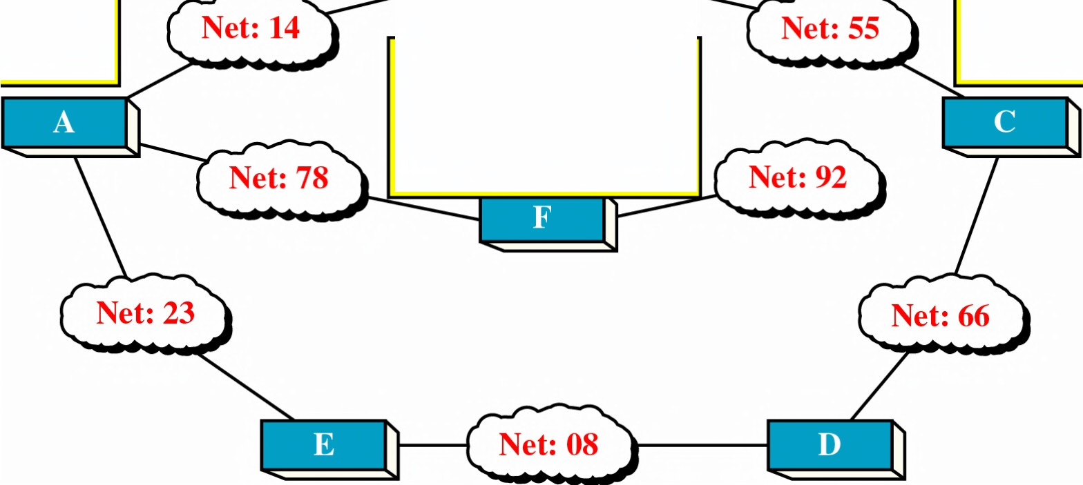
Distance
Vector
Routing
I periodically send my
knowledge about the
whole internetwork
to A, C.
I periodically send my knowledge
the whole network to B, F,
I periodically send
about
my knowledge
about
rnetwork the whole
E I periodically send to my knowledge about
the whole internetwork to A.
.
network to B, D.
I periodically send my knowledge about the whole internetwork to A, D.
I periodically send my knowledge about the whole internetwork to C, E.

Slide 5
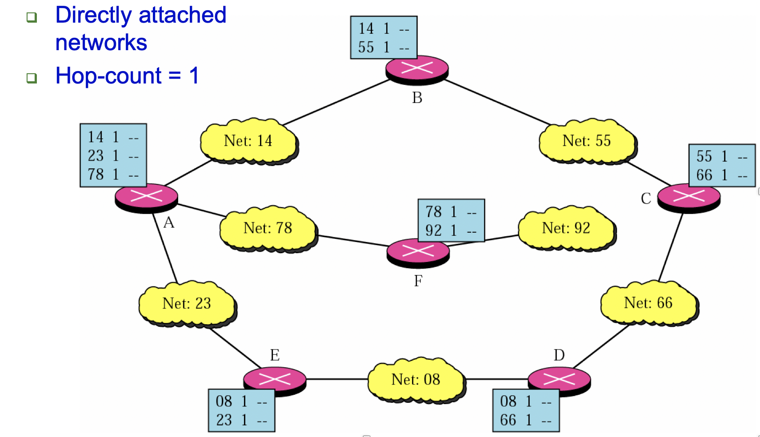
Initial Routing tables

Slide 6
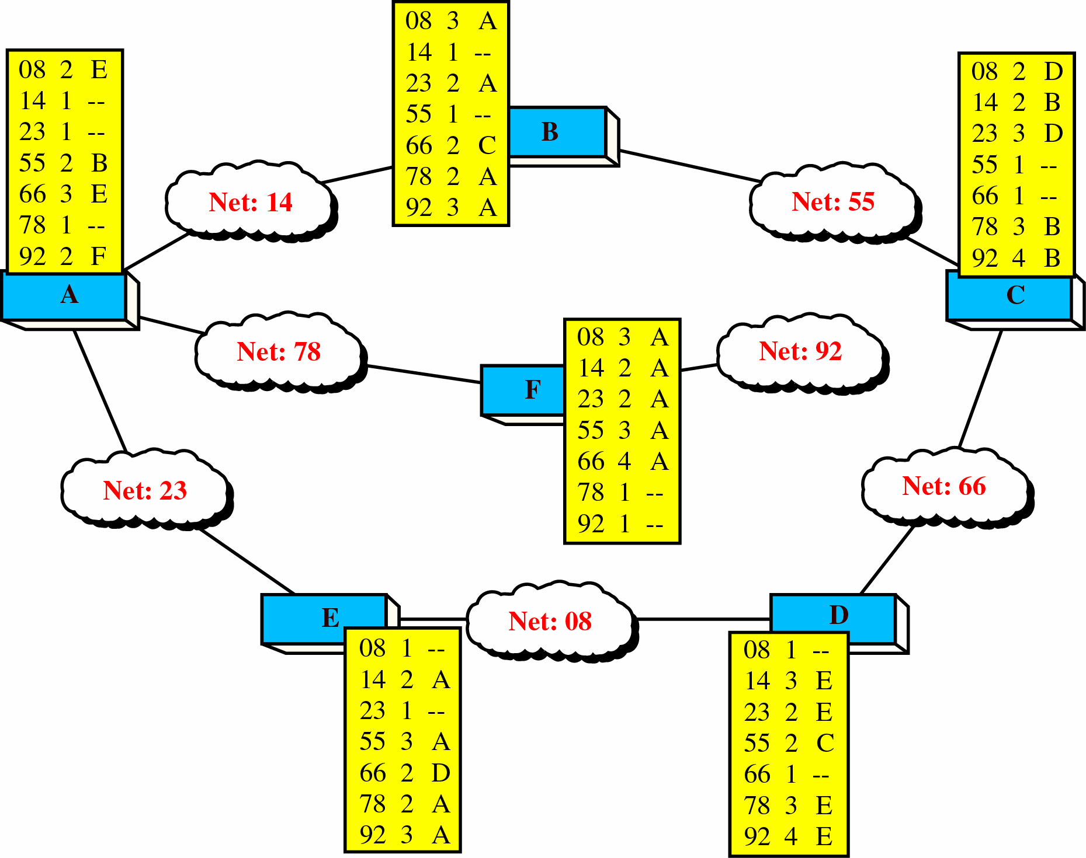
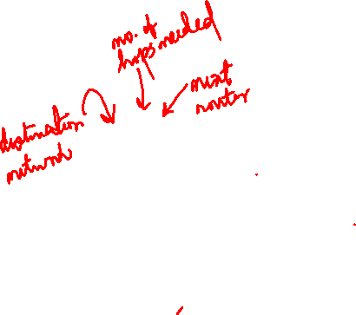
DV Routing
(cont.)
Tables
13-12
Final
Routing

Slide 7
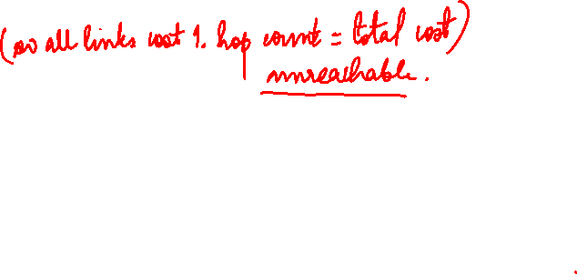
Routing Information Protocol
A simple intra-domain protocol
Straightforward implementation of Distance Vector Routing
Each router advertises its distance vector every 30 seconds (or whenever its routing table changes) to all of its neighbors
RIP always uses 1 as link metric
Maximum hop count is 15, with 􏰀16􏰁 equal to 􏰀¥􏰁
Routes are timeout (set to 16) after 3 minutes if they are not updated

Slide 8
Routing with RIP
Initialization: Send a request packet (command = 1, address family=0..0) on all interfaces:
RIPv1 uses broadcast if possible,
RIPv2 uses multicast address 224.0.0.9, if possible
requesting routing tables from neighboring routers
Request received: Routers that receive above request send their entire routing table
Response received: Update the routing table
Regular routing updates: Every 30 seconds, send all or part of the routing
tables to every neighbor in an response message
Triggered Updates: Whenever the metric for a route change, send the entire routing table.

Slide 9
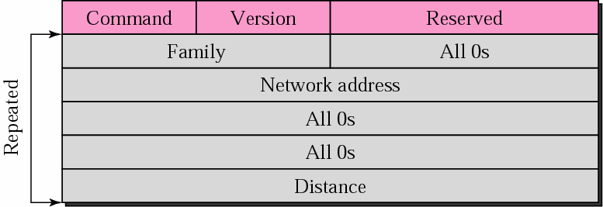
Routing Information Protocol
The simplest and the most widely used routing protocol in IP networks. Uses UDP for transport over the well-known port 520.
13-25
RIP
Message
Format
Address
1 – request
2 - response
family
identifier (TCP/IP
= 2)
An element of distance vector
Destination network (uses network rather router address)
than
Hop count between the advertising
router and the destination network
(value from 1 to 15; 16 means “network
unreachable”
The “next-hop” field is missing here.
It is included in the new version of RIP, RIP-2.

Slide 10
RIP Updating Algorithm

Slide 11
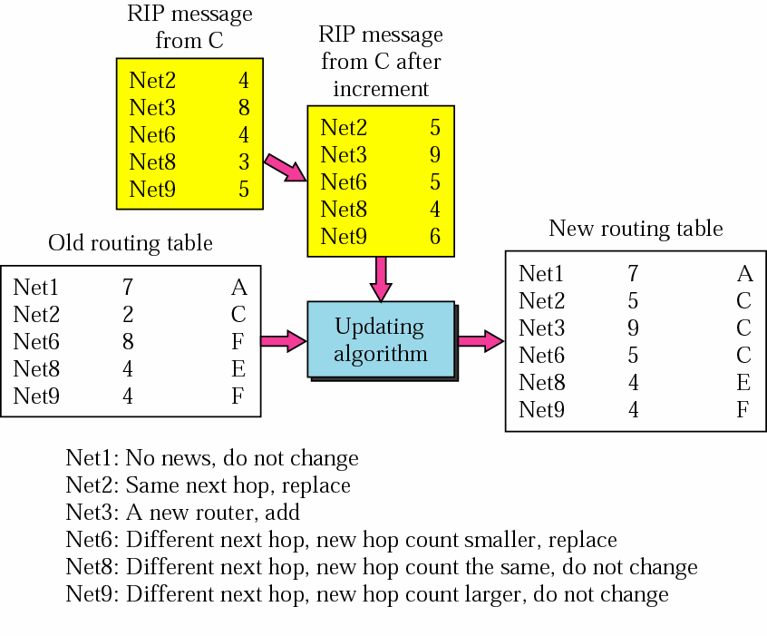
DV Routing (cont.)
13-11
Example
of
updating
a
routing
table
NOTICE: This example is not related to example networks on previous slides.
If the entry “Net2 5” is to be accepted by the router X, then the next hope for that entry would be C.
New
RT
of
router X
Old
RT of router X

Slide 12
DV Routing (cont.)
13-9
Updating
RT (Cont.)
4
Case a
Router
X
1
Network
N
Router
A
If optimal route A→N goes via X it
means that X is closer to N than A and therefore has to be trusted more, so the entry A→N via X = 2 is replaced by
A→N via X = 5
RT of A
Updated
RT of A
→N via X cost = 2
. . . . . . . . . . . . . . . . .
A→N via X cost = 5
. . . . . . . . . . . . . . . . .
replace
Advertising message from
X
X → N cost = 4
X→ N cost = 5
increment

Slide 13
DV Routing (cont.)
Updating RT
13-10
Case b
4
Router
X
Network
N
1
2
Router
A
This time the advertising router (X) is not
equal to next hop (Y), therefore the entry will be:
1
Router
Y
min{A→N
via Y = 3, →N via X = 5}
RT
of A
Updated
RT of A
A→N via Y cost = 3
. . . . . . . . . . . . . . . . .
A→N via Y cost = 3
. . . . . . . . . . . . . . . . .
minimize
Advertising message from X
X →N cost = 4
X→ N cost = 5
increment

Slide 14
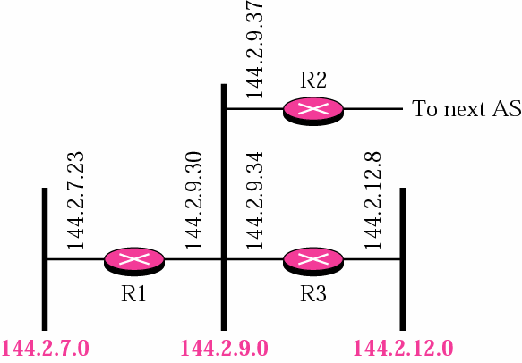
Example 1
13-27
What is the periodic response sent by router R1 in figure below?
Assume
R1
knows about the whole autonomous
system.
R1 can advertise three networks 144.2.7.0, 144.2.9.0, and
144.2.12.0.
The periodic response (update packet) is shown in next slide.

Slide 15
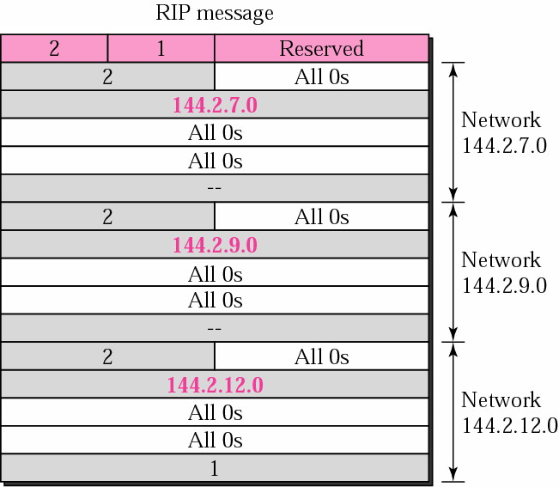
13-28
Periodic packet sent from
router
R1 to
its neighbors:

Slide 16
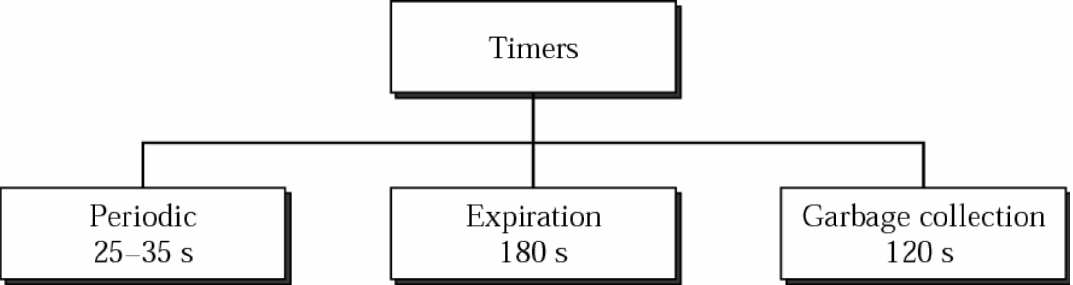
13-29
RIP
timers
Timer per router. Controls the advertising (time is a random number between 25-35 sec to avoid synchronization)
Timer per route (entry).
arrives. If the update doesn’t arrive in
is marked invalid by setting the
Timer per route (entry).
All invalid entries are purged 120 seconds after being determined invalid by X-timers. This gives a
chance that other routers learn that the specified network is unreachable
from this router.
which is reset whenever an update
180 seconds, the corresponding entry
distance to infinite (16).

Slide 17


13-31
Drawbacks of RIP:
Slow convergence
Too simple
Instability
Scalability
metric

Slide 18
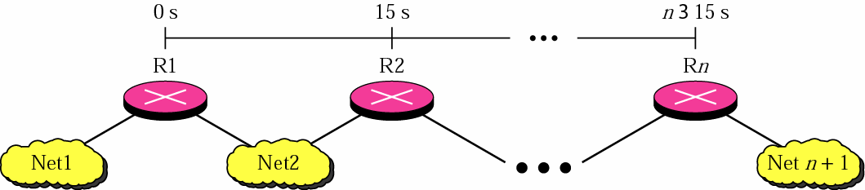
Slow convergence
Periodic advertisement every 30 seconds,
13-32
average propagation
time is
30/2
= 15
seconds
n x 15 s
This router learns about the change in
network 1 after n x 15 seconds.
(if n = 20, the delay would be 5 minutes)
Suppose there is a
change in network 1
In order to limit the delay, max hop count is limited to 15.
All entries that have distance 16 are considered invalid and are purged. Consequently the diameter of an AS that uses RIP is limited to15 hops.

Slide 19
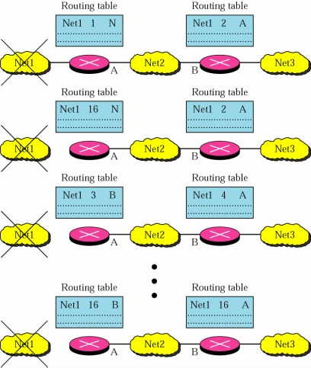
Instability
13-33
Loops of routing packets.
Limiting the hops to 15 helps but doesn’t solve the problem.
Net 1 fails. A updates its RT
with cost = 16, but advertises this after delay (max 30 sec).
In the meantime B sends
update with cost = 2. A chooses the cost 2+1 = 3, which is smaller than 16.
This continues until finally
realizes that the Net 1 is unreachable.
B

Slide 20


13-34
Remedies to Instability
Triggered updates
Split
horizons
Split
horizons
with
Poisoned
reverse

Slide 21
13-35
Triggered Updates
If there is a change in the router sends the update immediately
instead of waiting the update time (30 sec). Each router that receives information about change, forwards the update immediately.
This helps
in case from the previous slide,
but doesn’t help in case
of
a
router
failure
(because
there
is
no
one
to
report
such
change).

Slide 22
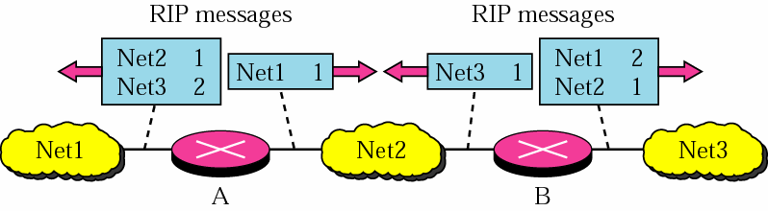
Split horizon
Router never advertises the cost of a destination to neighbor N
if N is the current next-hop for the destination
13-36
If a router has received an update from an interface, then this same
update
information
must not be forwarded
back
to the
same
interface.
B has received info about Net 1 and Net
through the right i/f only.
2 through its left i/f. This
info is forwarded
Router A is closer to destination (Net 1) than the router B, therefore there is not
meaningful that B supplies A with information about something that is closer to A.

Slide 23
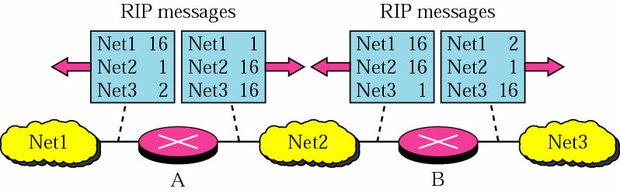
Split Horizon with Poisoned Reverse
13-37
Same
idea,
but
instead
of
no
advertisement
use
infinity
cost
The erroneous route will be eliminated within the interval of 180 seconds.

